Slide 1
Fake News
Biden: I Quit!
Notes:
The title of my news article is “Biden: I Quit!”

Slide 2
What about “Biden: I Quit!”
It is a fake news article.
It talks about Joe Biden, a presidential candidate in the forthcoming elections.
It says that Biden has withdrawn from the presidential race
Biden cites having considered quitting to concentrate on other issues
Notes:
My article is a fake news article. It claims that, Joe Biden, has decided to withdraw from the presidential race to concentrate on other issues.

Slide 3
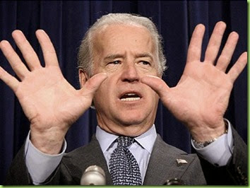
History of the Story
Joe Biden is a US presidential candidate
He is a former vice president during President Obama’s regime
His close competitor is Donald Trump, the current president of the United States.
Uses persuasive strategies.
Strategies enhance the message’s believability
Graphics, direct quoting, pictures etc
This Photo by Unknown Author is licensed under CC BY-SA-NC
Notes:
Looking at the history of my fake news article, there are various things to learn. First, Joe Biden is a aspirant in the forthcoming presidential candidate. He is a former vice president during President Obama’s regime. He is well-known public figure and therefore the article can capture great attention. . It uses various persuasive strategies to enhance its believability. These strategies are graphics direct quoting, use of influential personalities etc.

Slide 4

Results
The article was fake news.
Most people had agreed to the article.
People believed in the news
Trump supporters and the numerous republicans expressed their happiness
This Photo by Unknown Author is licensed under CC BY-ND
Notes:
Every person I presented the fake news to believed they were true at the first instance. Both democrats and republicans had a unique reaction to the news. Trump supporters and the numerous republicans expressed their happiness towards the news since they were pleasing to him.

Slide 5
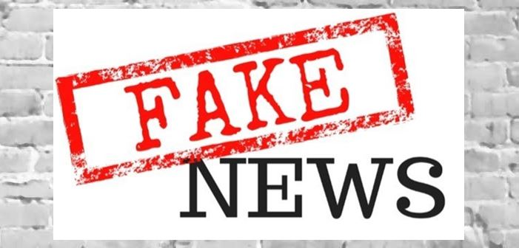
Discussion
Social Media, a great fake news facilitator.
Ensures that the target audience benefits them.
Benefits include public duping, click baits, and also creating site traffic.
Notes:
Social media, by far, is a great enabler of fake news. Publishers shares the news in these platforms to drive attention into their sites. Once attention is on their sites, they can benefit from advertising, creating traffic into their site and also act as click baits

Slide 6
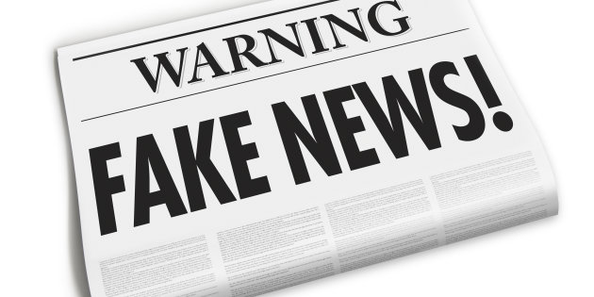
Conclusion
Fake news are meant to dupe the target audience.
Uses persuasive strategies.
Fake news are a hoax
Notes:
Fake news are prank orchestrated by certain publishers with various aims. One aim might be to defame, draw attention and also to persuade. The article was very persuasive due to the use of graphics, direct speech and close to true instances. Age was a great determiner of the people persuaded by the article since most of the victims of the news article is the elderly

Slide 7
References
Thompson Rivers University Library. (2003). Research Guides: Fake News: Characteristics of Fake News & Media Bias. Home - Research Guides at Thompson Rivers University Library. https://libguides.tru.ca/fakenews/characteristics
Brewer, P. R., Young, D. G., & Morreale, M. (2013). The impact of real news about “fake news”: Intertextual processes and political satire. International Journal of Public Opinion Research, 25(3), 323-343.
Evon, D. (2016, July 10). FALSE: Pope Francis Shocks World, Endorses Donald Trump for President. Snopes.com. https://www.snopes.com/fact-check/pope-francis-donald-trump-endorsement/
Brian Fung, CNN. (2020, March 3). States launch 'trusted information' efforts against fake news on social media. CNN. https://edition.cnn.com/2020/03/02/politics/state-efforts-against-social-media-misinformation/index.html
Notes:
Above are the references used for analysis

